Slide 1
Intrusion Detection, Snort, and Network Security Monitoring
Cybersecurity
Lesson 12.2

Slide 2

Learning Objectives
By the end of today’s lesson, you will be able to:
1
Interpret and define Snort rules and alerts.
2
Explain how intrusion detection systems work and how they differ from firewalls.
Use Security Onion and its suite of network security monitoring tools to trace the path of network attacks.
3
Collect and analyze indicators of attack (IOA) and indicators of compromise (IOC) using NSM tools.
4
Apply knowledge of NSM, Snort rules, and Security Onion to establish situational awareness within a network.
5

Slide 4


Security Onion Setup
Before we get started, we will need to log in to Azure and launch an instance of Security Onion.
Then we will generate alert data that we'll use later in the lesson. Specifically, a Security Onion VM will spin up and loaded PCAPs will be replayed.
Notes:
shutterstock_1888488028

Slide 6

Network security
Firewalls play a critical role in establishing a perimeter defense.
Firewalls do have their limitations. Advanced hackers can easily fool them through packet manipulation.
It's crucial to have a strong defense to help protect sensitive data.

Slide 7

Intrusion Detection
Systems (IDSs) and Snort

Slide 8
A firewall is a device used in network security designed to filter inbound and outbound traffic based on rules.

Slide 9


Firewalls Vs. IDSs
Firewalls make decisions to either allow or block traffic based on:
Source and destination IP address
Source and destination Port Number
Protocol type
Firewalls can be fooled through packet manipulation by clever hackers.

Slide 10
Intrusion detection systems (IDSs) are tools that can both analyze traffic and look for malicious signatures.

Slide 11

IDS
Intrusion detection system
An IDS is like a firewall in that it also:
Reads the data in the packets
Performs inspections
Issues alerts or alarms
Blocks malicious traffic
There are many IDSs, but today’s lesson
will be focusing on Snort.
IDS
IDS

Slide 12
Network Security Monitoring (NSM) is the process of identifying weaknesses within a network’s defense.

Slide 13



Intrusion Detection Systems
An IDS detects and alerts of an attack.
An IDS is passive.
It does not respond to attacks, it only logs and documents information for future analysis.
It helps organizations establish situational awareness of attackers and harden defenses.
IDS
Internet
Firewall

Slide 14
IDS Types
There are two types of IDSs:
Signature-based IDS
Anomaly-based IDS
Compares patterns of traffic to predefined signatures.
Good for identifying well-known attacks
Can be updated as new attack signatures are released
Vulnerable to attacks through packet manipulation
Unable to detect zero-day attacks
Compares patterns of traffic against a well-known baseline.
Good for detecting suspicious traffic that deviates from well-known baselines
Excellent at detecting when attackers probe and sweep a network
Prone to false alerts
Assumes network behavior does not deviate from well-known baselines

Slide 15


IDSs Have Two Basic Architectures
Network IDS (NIDS)
Filters an entire subnet
on a network
Host-Based IDS (HIDS)
Runs locally on a host-based system, or user’s workstation or server

Slide 16


Network IDS (NIDS)
Matches all traffic to a known library of attack signatures
Passively examines network traffic at points that it’s deployed
Relatively easy to deploy and difficult to detect by attackers
Internet
NIDS
Packet Sniffer

Slide 17

Host-Based IDS (HIDS)
Acts as a second line of defense against malicious traffic that successfully gets past a NIDS
Examines entire file systems
on a host, compares them to previous snapshots or baselines, and generates an alert if there are significant differences between the two
Internet
HIDS
HIDS
HIDS
Log
Log
Log
Centralized Control Model

Slide 18

Intrusion Prevention System (IPS)

Slide 19

An intrusion prevention system (IPS) can do everything an IDS can, but it can also respond to attacks.
An IPS can react to packets by blocking malicious traffic, preventing it from being delivered to a host on
the network.
Notes:
shutterstock_1223372530

Slide 20

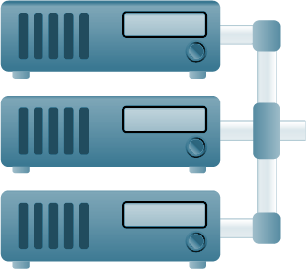



IDS Vs. IPS
An IDS connects via a network TAP or mirrored SPAN port.
Network TAP is a hardware device that provides access to a network. Network TAPs transit both inbound and outbound data streams on separate channels at the same time so all data will arrive at the monitoring device in real time.
SPAN sends a mirror image of all network data to another physical port where the packets can be captured and analyzed.
An IDS requires an administrator to react to an alert by examining what was flagged.
IDS
Internet
IDS
Firewall
Management System
Switch
Corporate Network

Slide 21

IDS Vs. IPS
An IPS connects inline with the flow of data, typically between the firewall and network switch.
IPS
An IPS requires more robust hardware due to the amount
of traffic.
It will automatically take
action by blocking and logging
a threat, so it doesn’t require administrative intervention.
Internet
Firewall
IPS
Management System
Switch
Corporate Network

Slide 22

IDS
Alerts are generated when a rule detects a malicious signature or traffic.
An alert message that’s created and sent goes to the analyst’s console as an IOA.
There are two primary types of indicators: IOA and IOC.

Slide 23
IDS Alerts
Indicators can be either:
Indicator of attack
Indicator of compromise
IOAs indicate attacks happening in real time.
Proactive approach to intrusion attempts
Indicate that an attack is in progress, but a full breach has not been determined
Focus on revealing the intent and end goal of an attacker, regardless of the exploit or malware used
IOCs indicate previous malicious activity.
Indicate that an attack has occurred, resulting in a breach
Used to establish an adversary’s techniques, tactics, and procedures (TTPs)
Expose all vulnerabilities used in an attack, giving network defenders the opportunity to revamp their defense as part of their mitigation strategy

Slide 24

Snort is one of the world’s most popular
open-source network IDSs/IPSs.

Slide 25
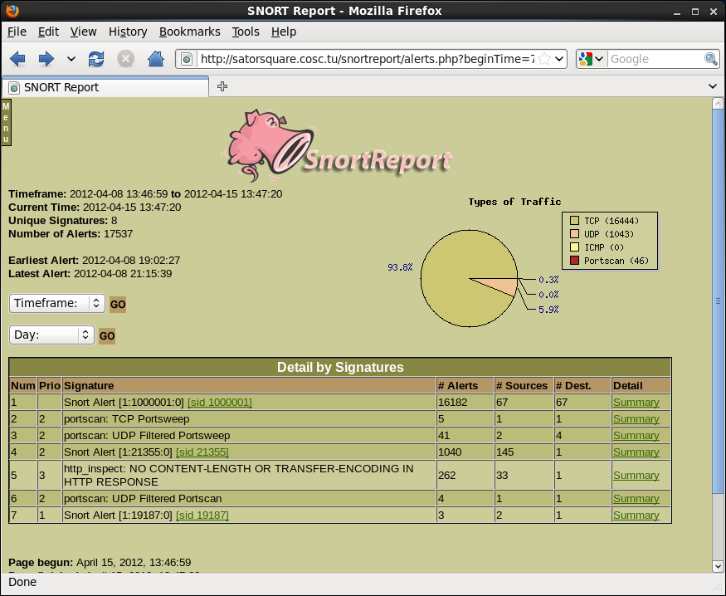
Snort
Snort can perform real-time traffic analysis and log packets on a network.
It adds additional layers of defense that can be applied at various layers of the defense-in-depth model, including:
Perimeter IDS and IPS architecture
Network IDS and IPS architecture
Host IDS and IPS architecture

Slide 26



Snort
Snort can operate in three different modes:
Sniffer
Packet Logger
NIDS
Reads network packets and displays them on screen
Performs packet captures by logging all traffic to disk
Monitors network traffic, analyzes it, and performs specific actions based on administratively defined rules

Slide 27
Snort Rules
Snort uses rules to detect and prevent intrusions. It operates by:
01
Reading a configuration file
02
Loading the rules and plugins
03
Capturing packets and monitoring traffic for patterns specified in the loaded rules
04
generating an alert when traffic matches a rule pattern or else logging the matching packet for later inspection

Slide 28
Snort Rules
Rules direct Snort to monitor for:
OSI Layer
Watch for IP and TCP data
Source and Destination Address
Traffic flow
Byte Sequences
Patterns in packets

Slide 29
Snort Rules
This rule logs the message “IP Packet Detected” when it detects an IP packet.
alert ip any any -> any any {msg: "IP Packet Detected";}

Slide 30
Snort Rules
Rule Header
Rule Option
alert
Action Snort will take when triggered
any
Applies to packets coming from any source IP address
10.199.12.8
The destination
IP address
alert tcp any any -> 10.199.12.8 21 {msg: "TCP Packet Detected";}
tcp
Applies rule to all TCP packets
any
Applies the rule to packets from any port
21
Applies the rule
to traffic to destination port 21
{msg: "TCP Packet Detected";}
The message printed with the alert

Slide 31
Intrusion detection systems and Snort
In this activity, you will play the role of an SOC analyst for the California Department of Motor Vehicles (DMV).
Your CISO has advised you to implement new security controls as an added layer of protection for the driving records of all state citizens.
In this activity, you will strengthen your knowledge of the concepts related to IDSs and Snort.
15 minutes

Slide 34

NSM and
Security Onion

Slide 35

Network Security Monitoring
NSMs can provide situational awareness for an entire network.
We will review Security Onion, which uses Suricata as its event-driven mechanism.
Suricata provides Security Onion with alerts based upon configured rules similar to Snort rules.
Suricata provides features such as:
TLS certificates
HTTP requests
DNS transactions

Slide 36

NSM Case Study
On October 2023, a group of attackers released confidential information from 23andMe, a company that offers DNA testing. The exposed information contained personally identifiable information (PII) for many of its users, including usernames, full names, home addresses, social security numbers, and genealogical information.
Assailants had lurked on 23andMe’s network for about two months.
The compromise was achieved using a technique known as “credential stuffing.”
PII of many of its users was exposed.
23andMe suffered enormous damage
to its reputation.

Slide 37

If 23andMe had a strong NSM program in place,
it would have discovered the attack much sooner—perhaps within hours—stopped it, and got
a better understanding of the TTPs of the attacker.
Notes:
shutterstock_295554713

Slide 38
NSM is most useful when the frontend layers of defense
are compromised.

Slide 39

NSM
Work to slow or eliminate threat-based attacks
NSMs are:
  Threat-Centric
    Primary focus is adversary
  Focused on Visibility of Attack
    Not the response to the attack
  Reveal Statistical Data
    Specific IOAs and IOCs from attacks

Slide 40
NSM Strengths
NSM allows organizations to:
Track adversaries through a network and determine their intent
Acquire intelligence and situational awareness
Be proactive by identifying vulnerabilities
Be reactive through incident response and network forensics
Provide insights related to advanced persistent threats (APTs)
Uncover and track malware

Slide 41
NSM Weaknesses
NSM capabilities are extremely limited in the following situations:
Encrypted traffic and VPNs
Underpowered hardware
Mobile communication platforms
Legal and privacy issues
Limited access to network taps

Slide 42

NSM Stages and Processes
NSM operates in two stages, each involving two processes:
01
Detection
An alert is generated in the Security Onion analyst console.
02
Response
A security team responds
to a security incident.

Slide 43
NSM Stages and Processes
Detection: An alert is generated in the Security Onion analyst console.
Collection
The event is observed and the data
is stored in the form of a PCAP file.
Analysis
The alert data is identified, validated, documented, and categorized
according to its threat level.
Analyst Console(s)
Host data
Net data
IOC-centric analysis
or “matching”
Application logs
Data from third party
IOC-free analysis
or “hunting”
Data from constituent
Event Observed/Stored
Identification
Validation
Documented
Request for More Data

Slide 44
NSM Stages and Processes
Response: Security team responds to a security incident with two processes:
Escalation
All parties are notified.
Resolution
The process of containment, remediation, and any additional necessary response.
Analyst Console(s)
Constituent Portal
Constituent notification
Constituent response
New IOC creation
Additional response
New collection requirement
Collection improvement
New analysis requirement
Analysis improvement
Notification
Acknowledgement
Containment
Remediation

Slide 45
IDSs
IDSs are generally placed at strategic points where traffic is most vulnerable.
These devices are typically placed next to a router or switch that filters traffic.
IDS
Internet
Switch
Firewall

Slide 46

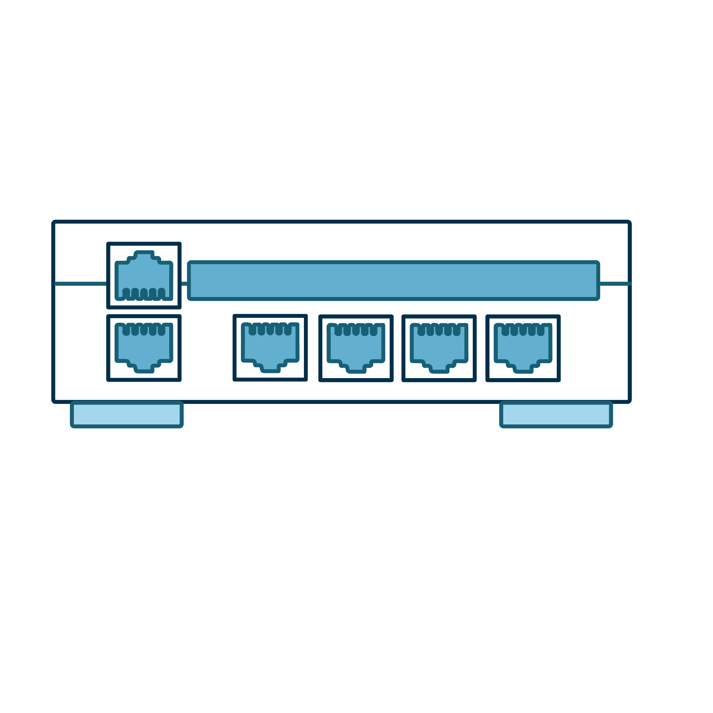
NSM Sensor Connectivity
SPAN or Mirrored Port
Function of an enterprise-level switch that allows you to mirror one or more physical switch ports to another port.
Network TAP
The most common type is
an aggregated TAP in which a cable connects the TAP monitor port with the NIC on the sensor. This specific placement allows traffic to be monitored between the router and switch.

Slide 47




NSM Sensor Connectivity
SPAN or mirrored port
With a SPAN port, the IDS can perform packet captures on all inbound and outbound traffic in a network.
24 Port Switch
Port 1
Port 2-23
Attached to port 24;
mirrored traffic
from port 1
Router
Network Assets
Sensor

Slide 48

NSM Sensor Connectivity
Network TAP
TAPs allow us to access our network and send that data in real time
to our monitoring systems.
TAP
Router
Switch
Sensor

Slide 49
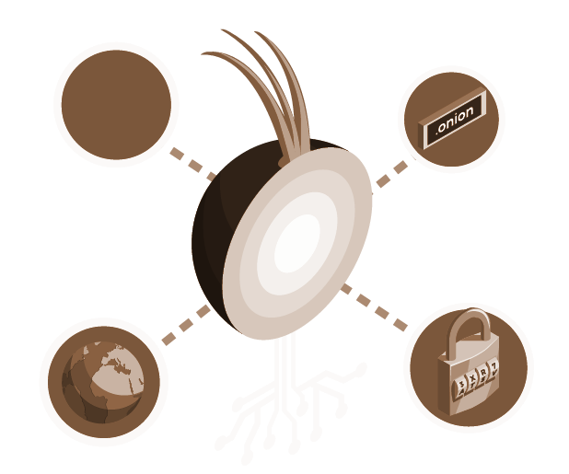
Security Onion is an NSM platform that provides context, intelligence, and situational awareness of a network.
Security Onion 2.4 is based upon Oracle Linux 9.

Slide 50
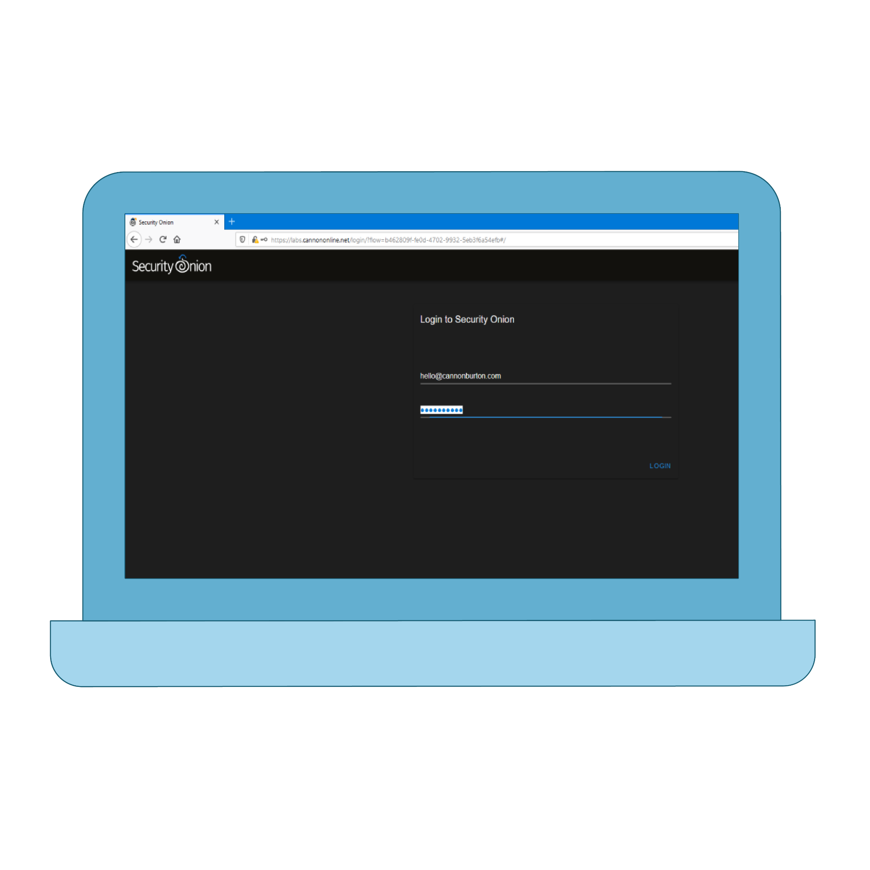
Security Onion
There are two ways to work with Security Onion:
Shell Interface
Web Browser

Slide 51
Security Onion contains a variety of NSM tools used to monitor and protect networks from attacks.

Slide 52






Security Onion
NSM tools
Alerts
Hunt
Cases
NetworkMiner
PCAP

Slide 53
Security Onion Alerts
Security Onion Alerts has six key functions that help with analysis:
Performs simple aggregation of alert data records
Makes available certain types of metadata
Allows queries and review of alert data
Allows queries and review of session data
Allows easy transitions between alert or session data and full content data
06
Counts and classifies events, enabling escalation and other incident response decisions

Slide 54
Security Onion Interface
Security Onion has four main sections:
1. Alert Count | Displays a total for the number of events of a specific type
2. Rule Name | The Suricata rule that generated the alert, obtained from the IDS engine
3. Event Module | The module that detected the event (Suricata)
4. Event Severity | Provides a rating for how severe an event should be considered

Slide 55
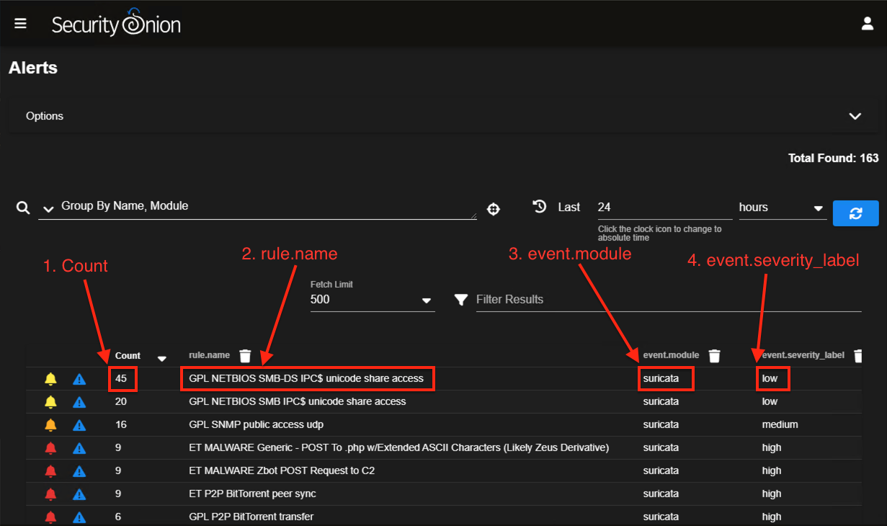
Security Onion Alert Panel

Slide 56
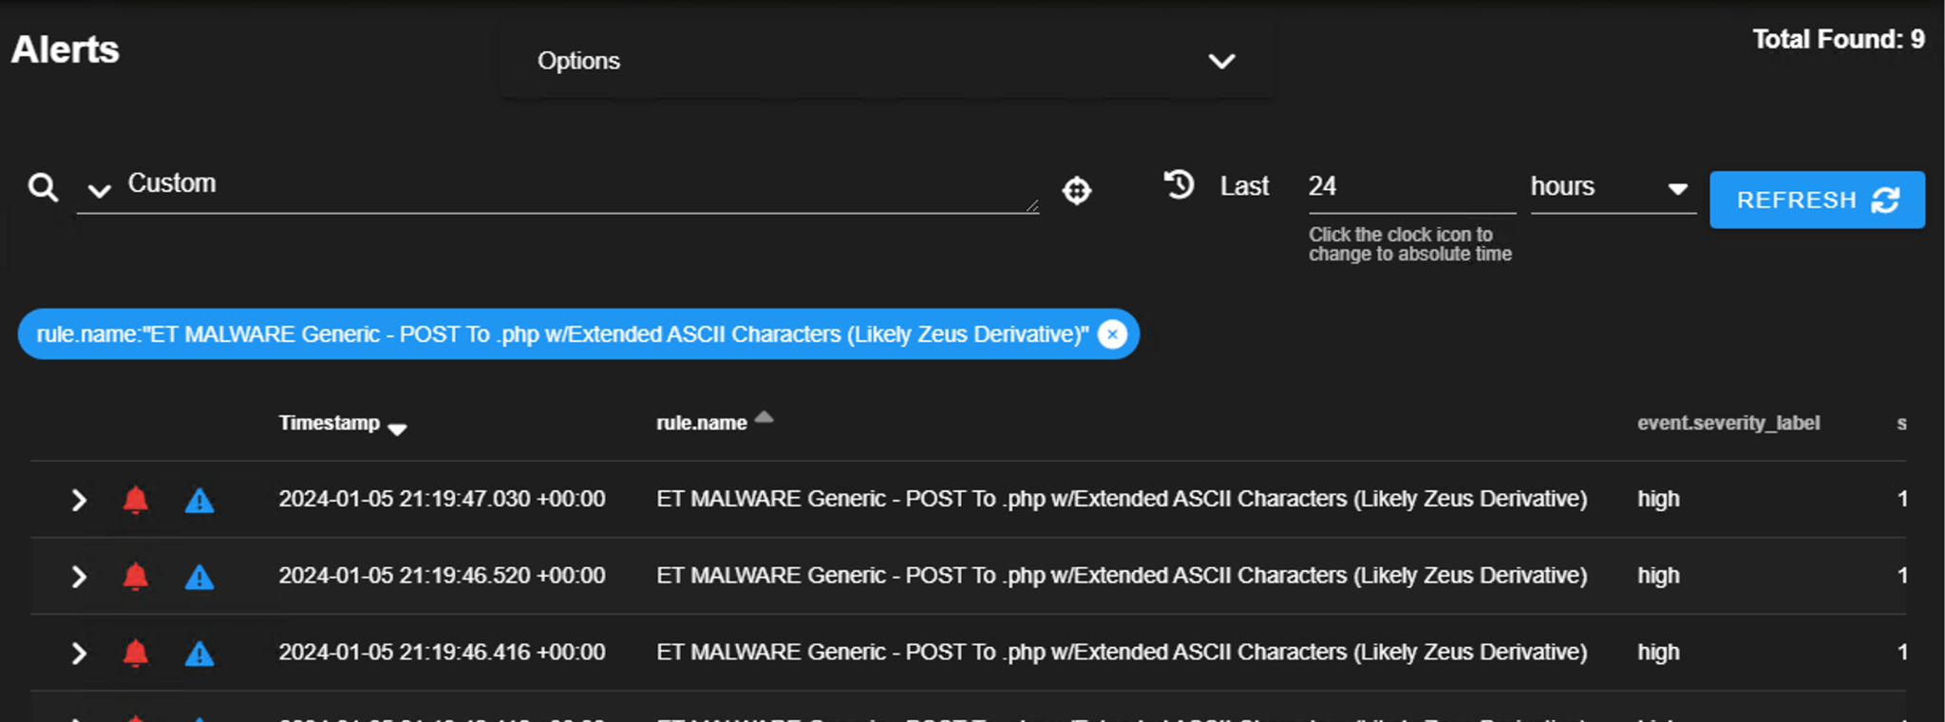
Security Onion Alert Panel Drilldown
rule.name | Packet Data
In the top portion of this window is the Suricata engine that generated the alert data when traffic matched one of its rules. Alert data is an indicator of attack (IOA). An analyst may have to determine if it represents benign or malicious activity. Alert data from the Suricata NIDS stores entries in the Event Messages column that begin with text like “ET” (for “Emerging Threats,” an IDS rule source). | The lower portion of the panel displays a network packet analysis matching the filter criteria. Expanding the entries in the packet analyzer presents a detailed view of the data capture.

Slide 57
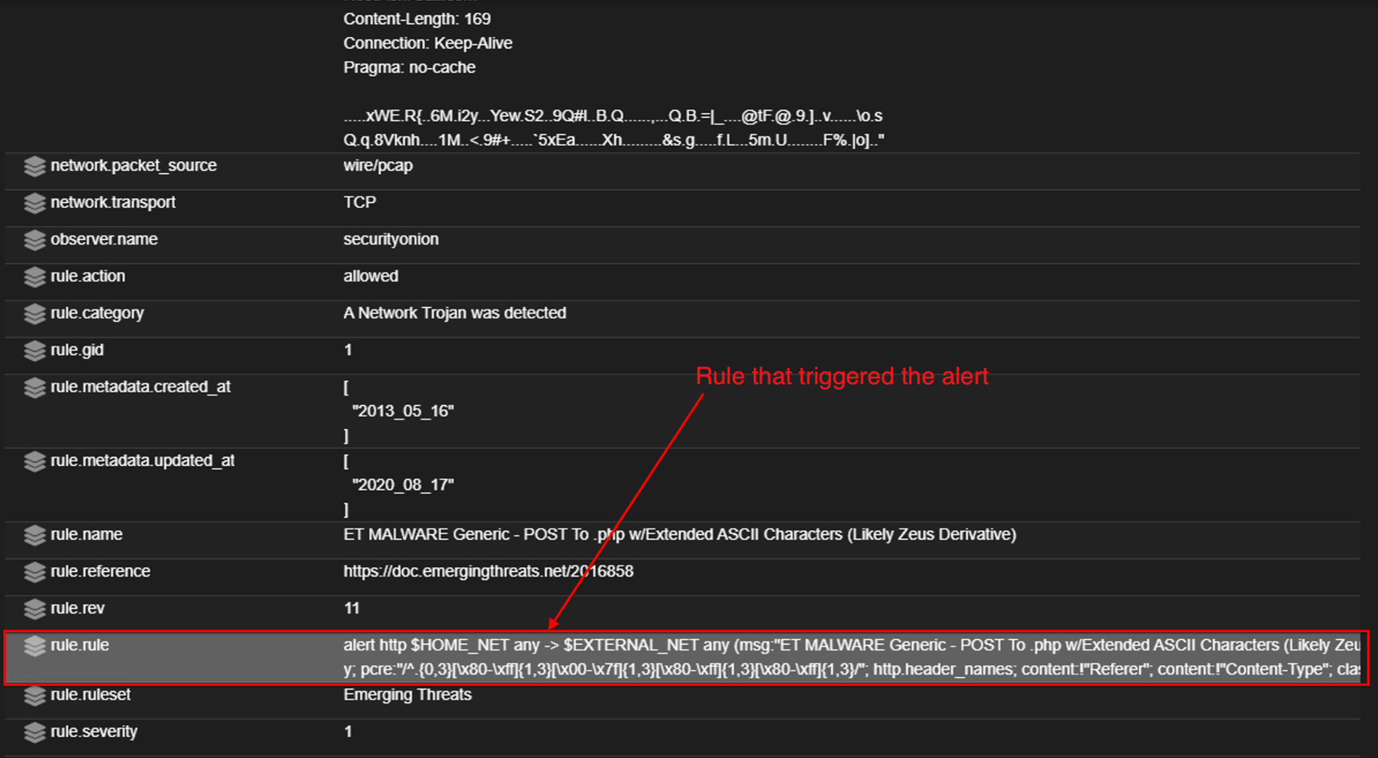
Expanding Security Onion Alert Data
This section of Security Onion’s console provides information regarding the alert.
This information is used
to reveal identifying information about the attacker, including domain name registries and IP addresses.
Other information may include country of origin and possibly the names, email addresses, and time of the event.

Slide 58
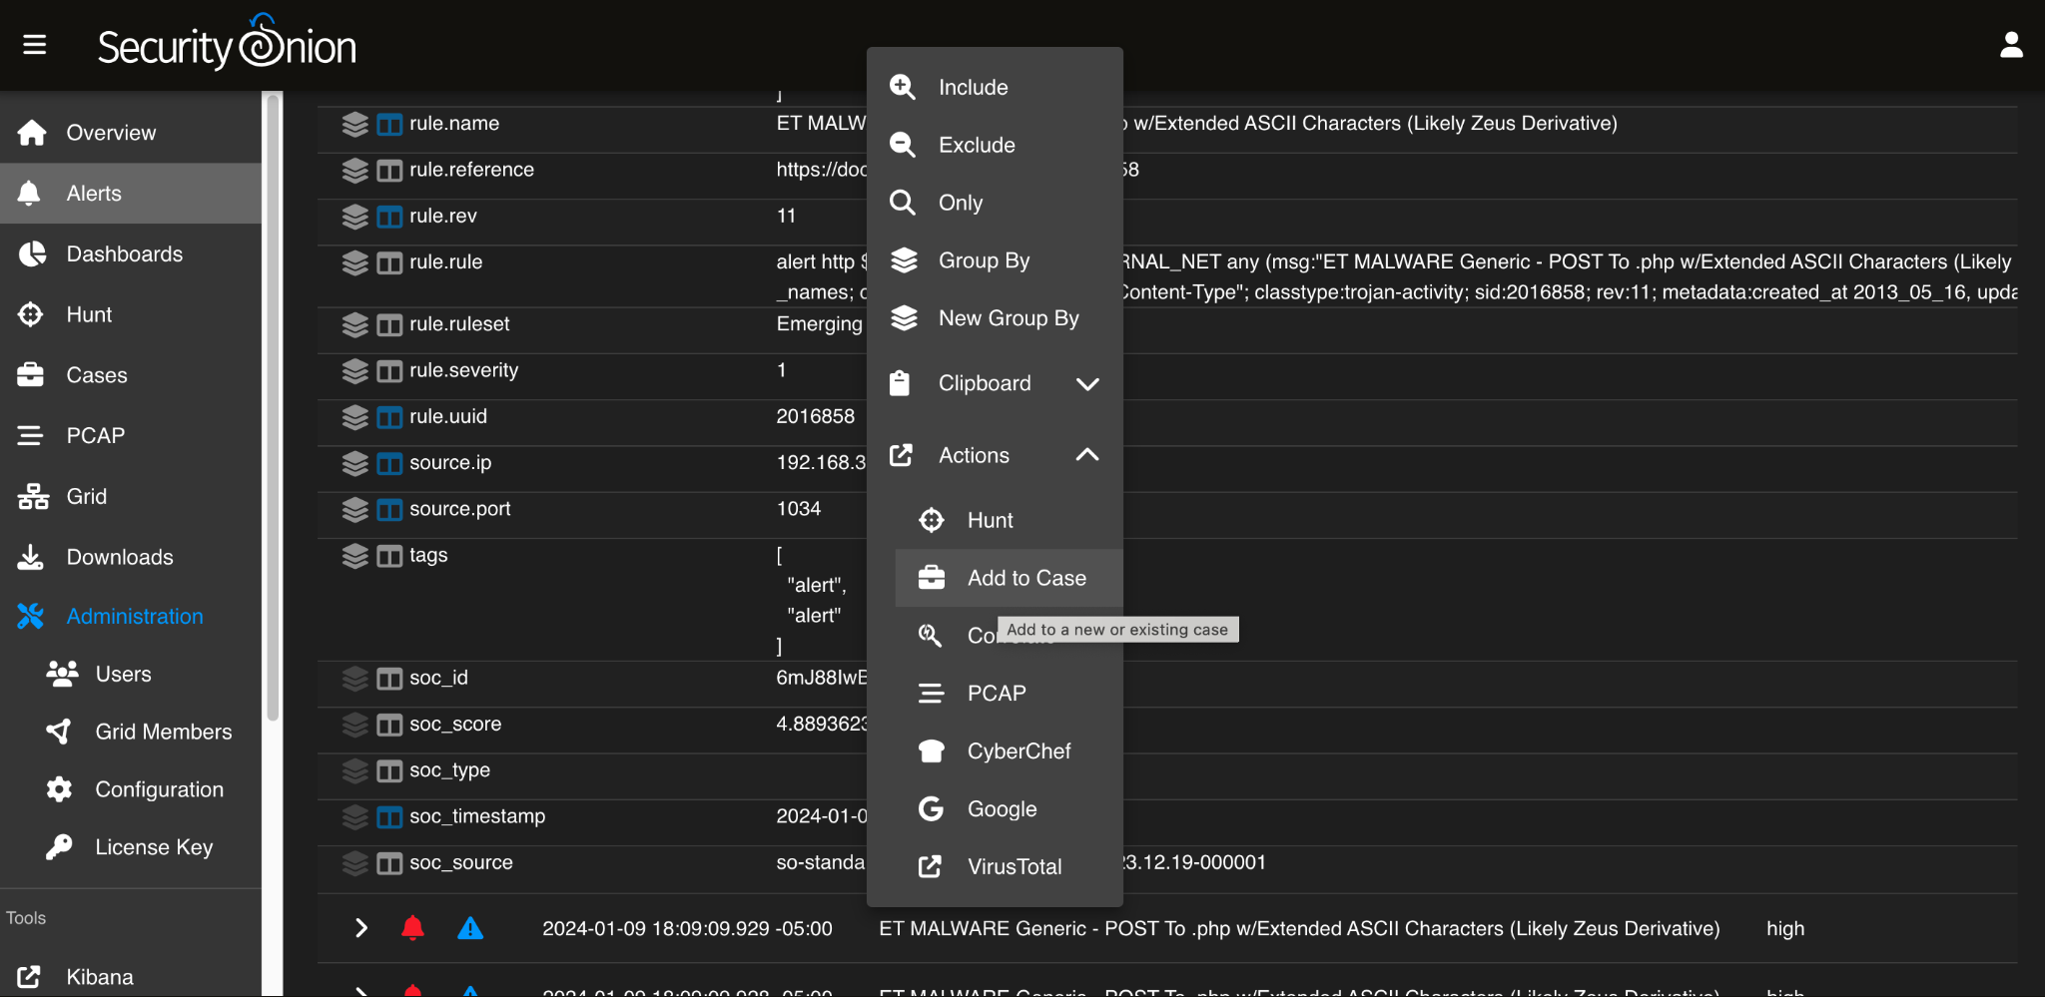
Incident Management and Case Creation
Inspecting an alert might lead to a decision to escalate for further investigation.
Security Onion lets you create a new case or add to an existing one.
Creating a case allows analysts to manage incidents and involve senior analysts when needed.

Slide 59
Security Onion and NSM
In this activity, you will continue your role as an SOC analyst for the California DMV.
It’s critical for your organization to understand the limits of what it can detect, adversarial tactics, and how to quickly apply lessons learned to mitigate newly discovered security vulnerabilities.
For this activity, you will strengthen your knowledge of concepts related to Security Onion and network security monitoring (NSM).
20 minutes

Slide 63

HTTP File Extraction

Slide 64

Security Onion Demonstration Setup
Sometimes an alert requires an analyst to do data mining.
A security analyst must have a thorough understanding of how NSM tools are integrated.
These skills help speed up incident and response efforts.

Slide 65
In the next guided tour,
we’ll use Security Onion as the starting point for learning other NSM tools
for security investigations.

Slide 66
Security Onion

Slide 67
FTP File Extraction
In this activity, you will continue your role as an SOC analyst for the California DMV.
Immediately after deploying your new defenses, your organization experienced an attack.
You need to examine an alert to determine if any systems were breached and if any data was supplanted or exfiltrated from the network.
20 minutes

Slide 70
Enterprise security management (ESM)

